Slide 1
Watlab Flood Simulation post analysis
Yuan-Hung Chiu
2025/12/08

Slide 2
Contents
Cross-section system construction
Flood flow computation
Wave propagation analysis
Single-section analysis

Slide 3
Contents
Cross-section system construction
Flood flow computation
Wave propagation analysis
Single-section analysis

Slide 4
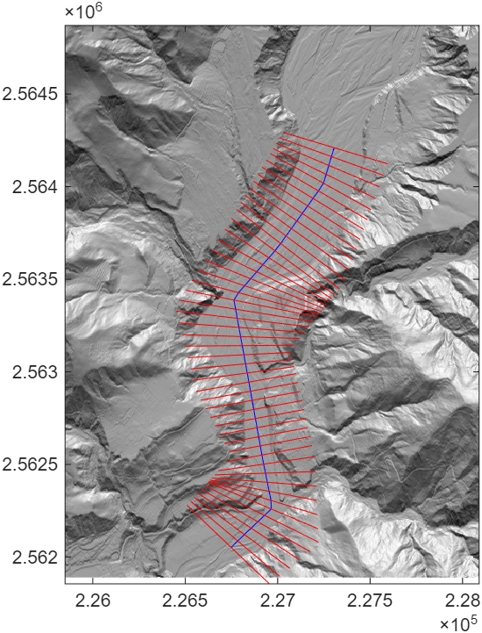
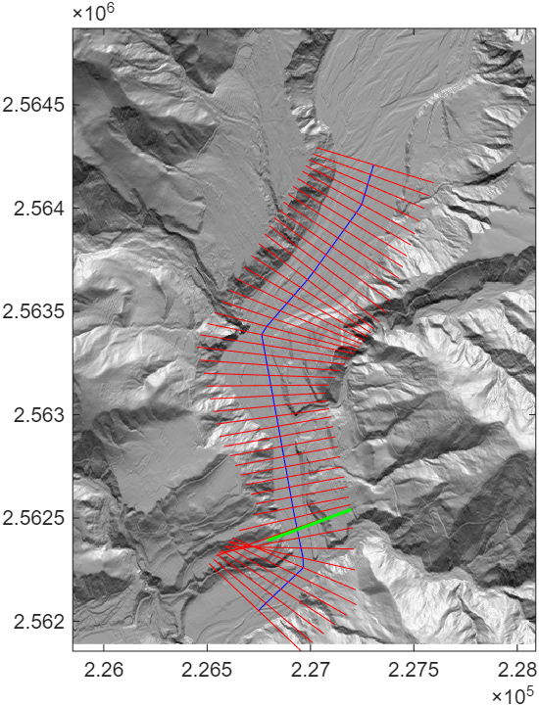
Approach 1
Approach 2

Slide 5
Contents
Cross-section system construction
Flood flow computation
Wave propagation analysis
Single-section analysis

Slide 6
Compute the flood
segment

Slide 7
Contents
Cross-section system construction
Flood flow computation
Wave propagation analysis
Single-section analysis

Slide 8
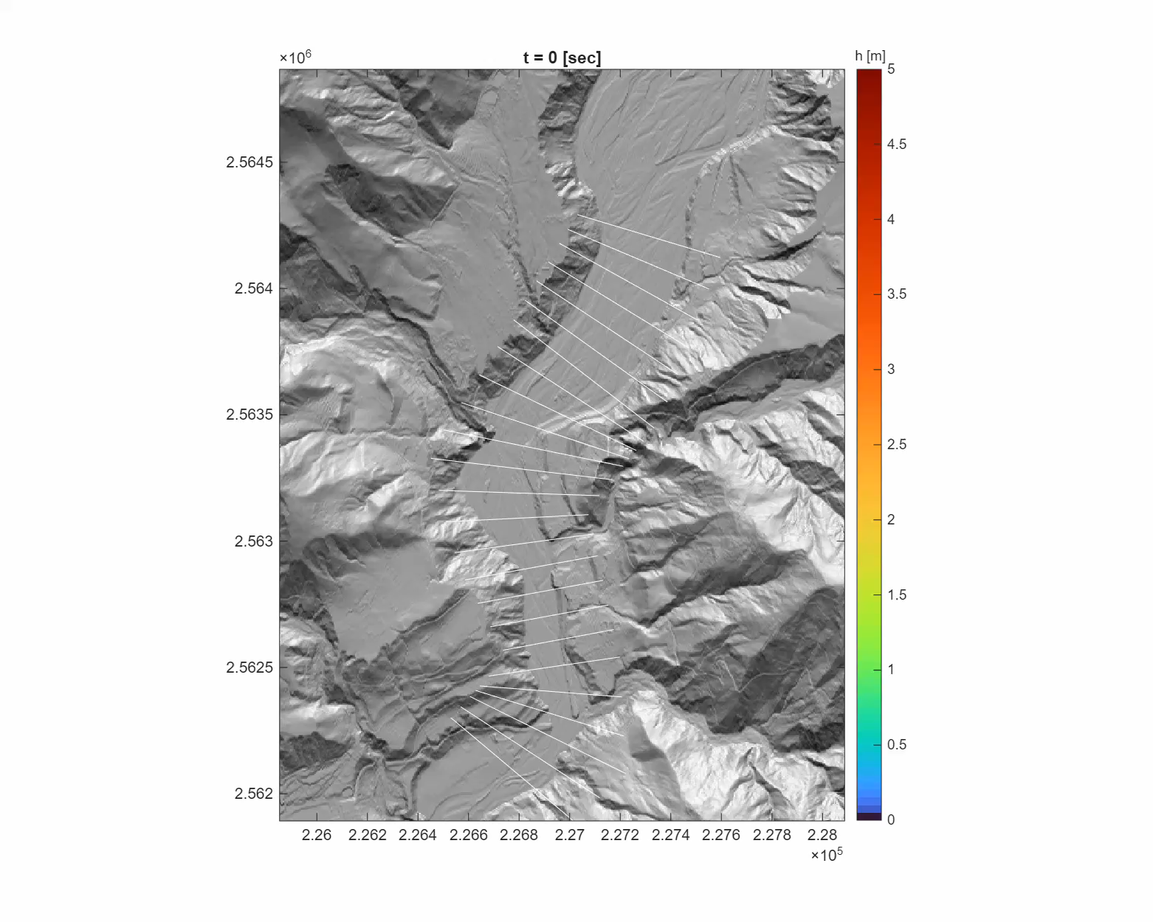

Slide 9
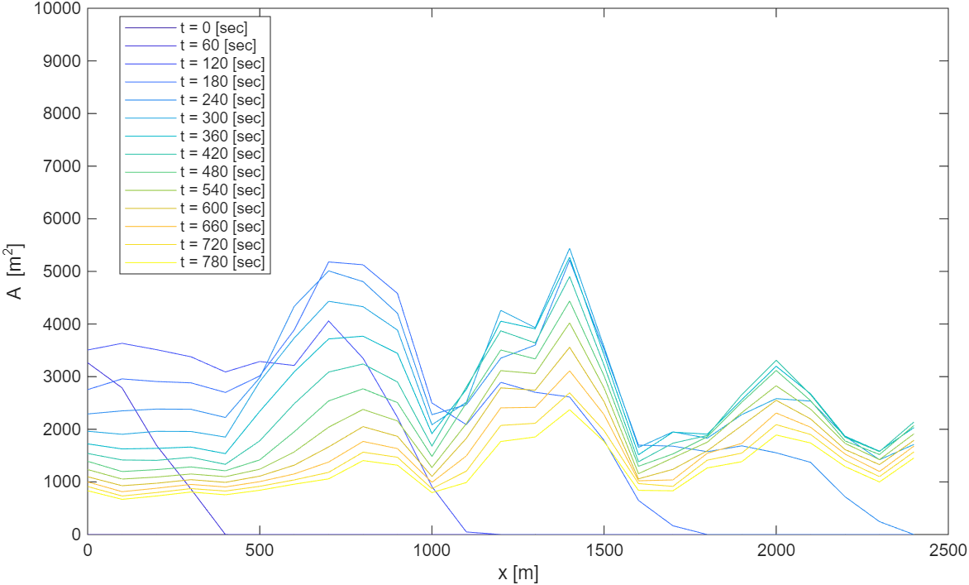
X-A Plot

Slide 10
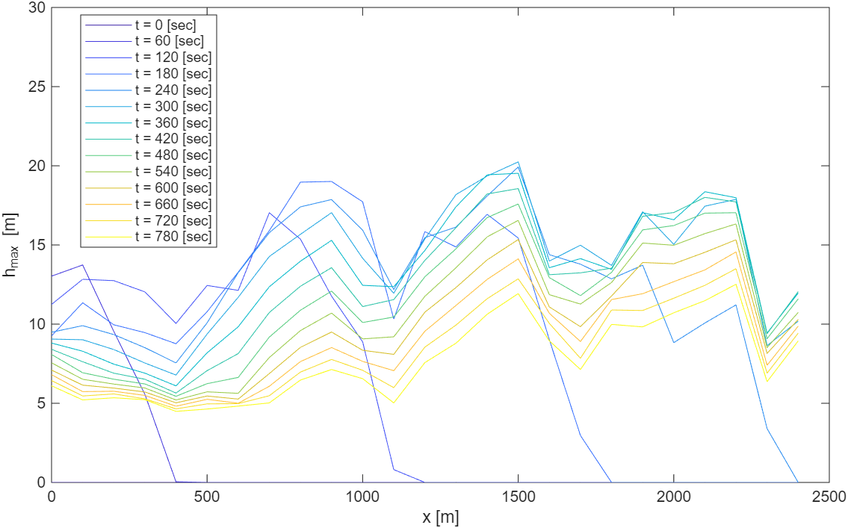
X-h Plot

Slide 11
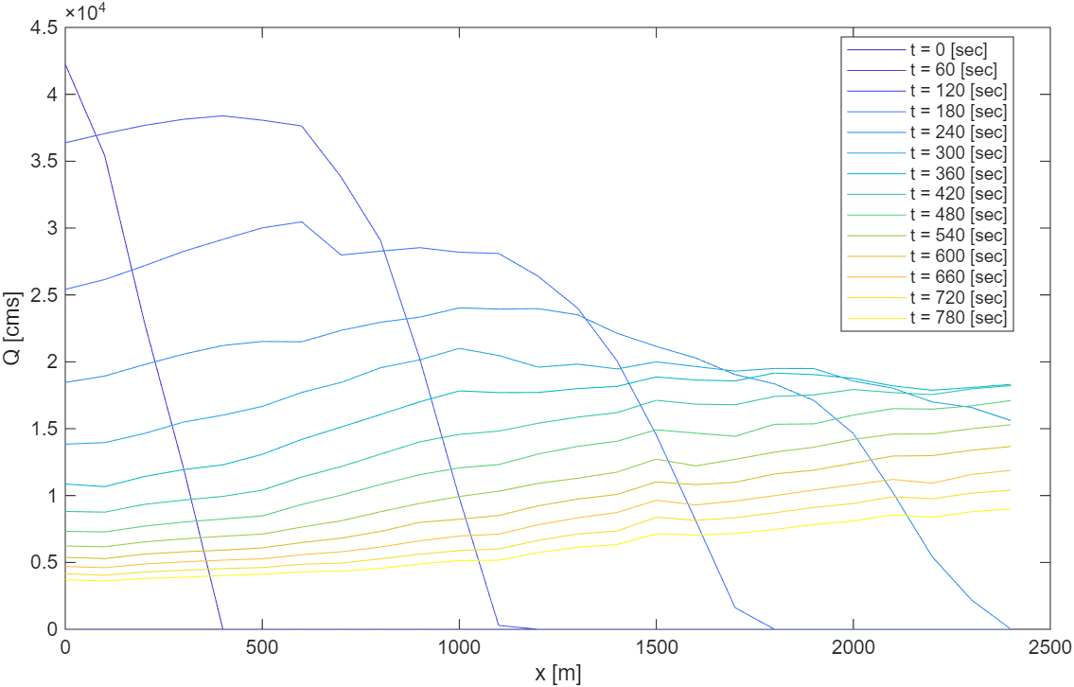
X-Q Plot

Slide 12
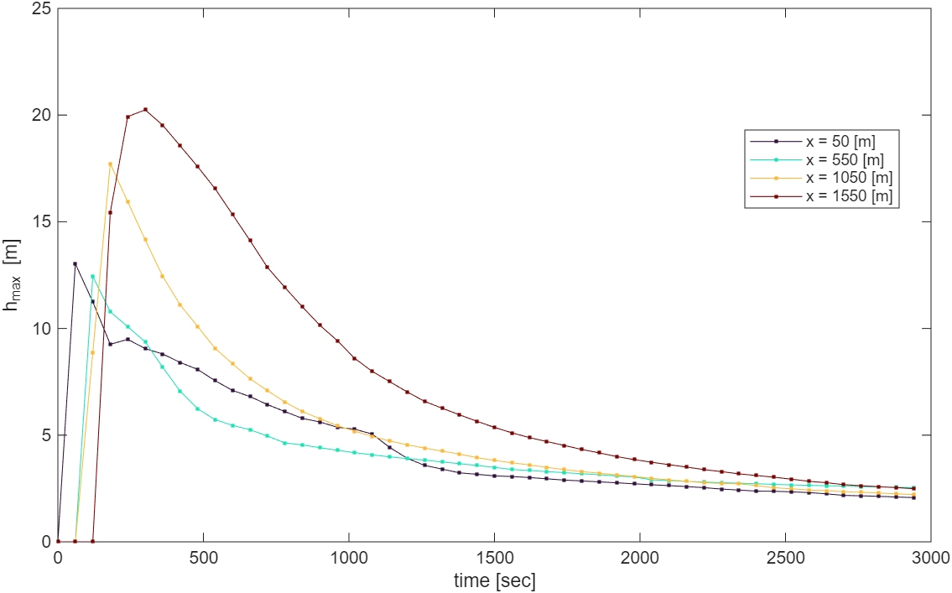
t-h Plot

Slide 13
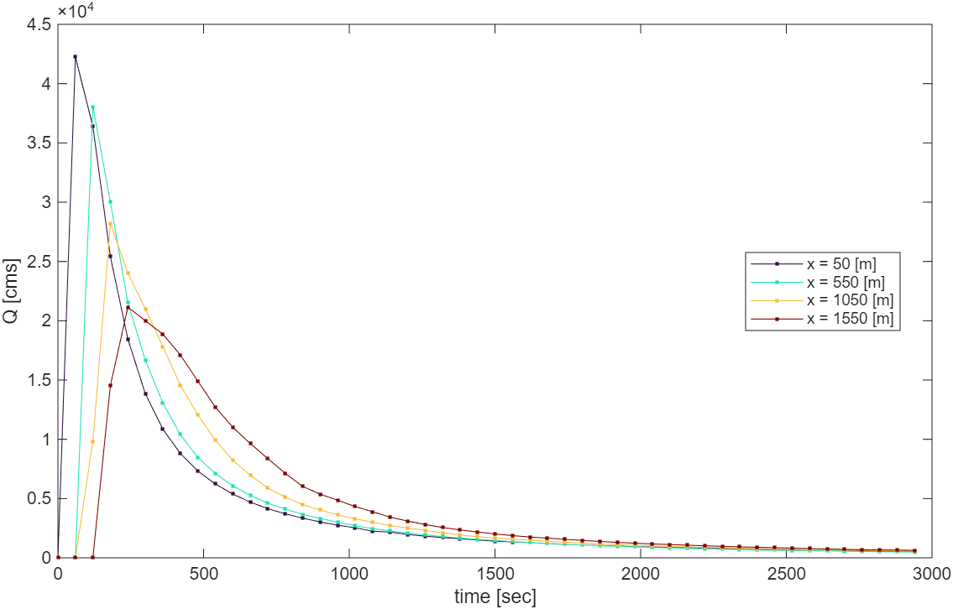
t-Q Plot

Slide 14
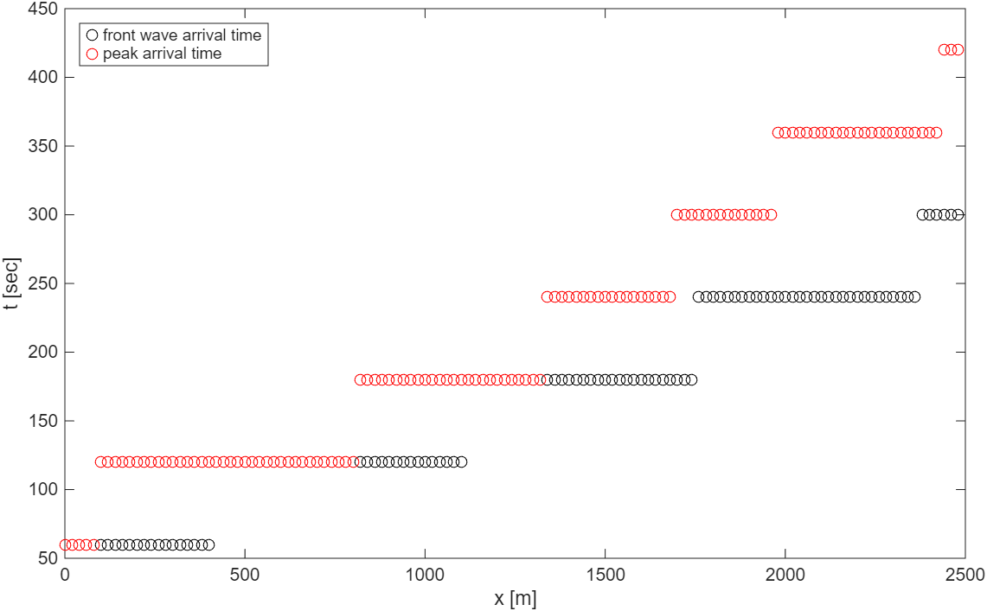
X-t plot (watlab output time step = 60 [sec]. )

Slide 15
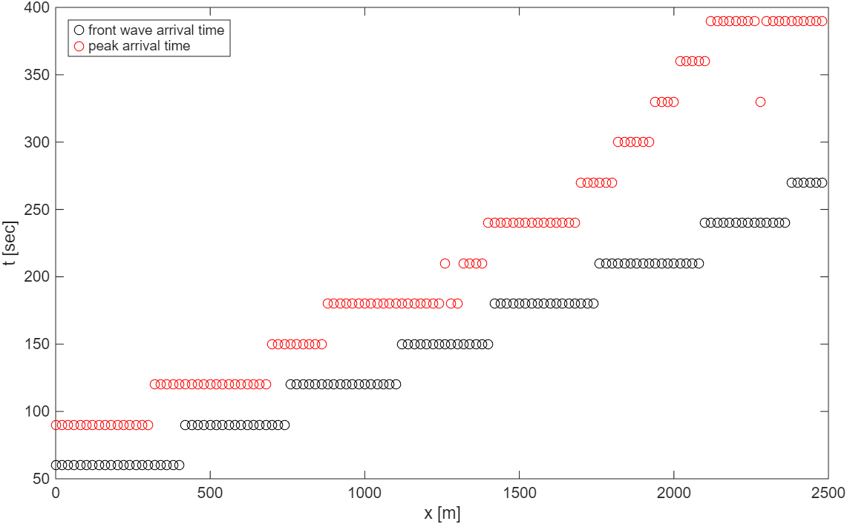
X-t plot (watlab output time step = 30 [sec]. )

Slide 16
Contents
Cross-section system construction
Flood flow computation
Wave propagation analysis
Single-section analysis

Slide 17
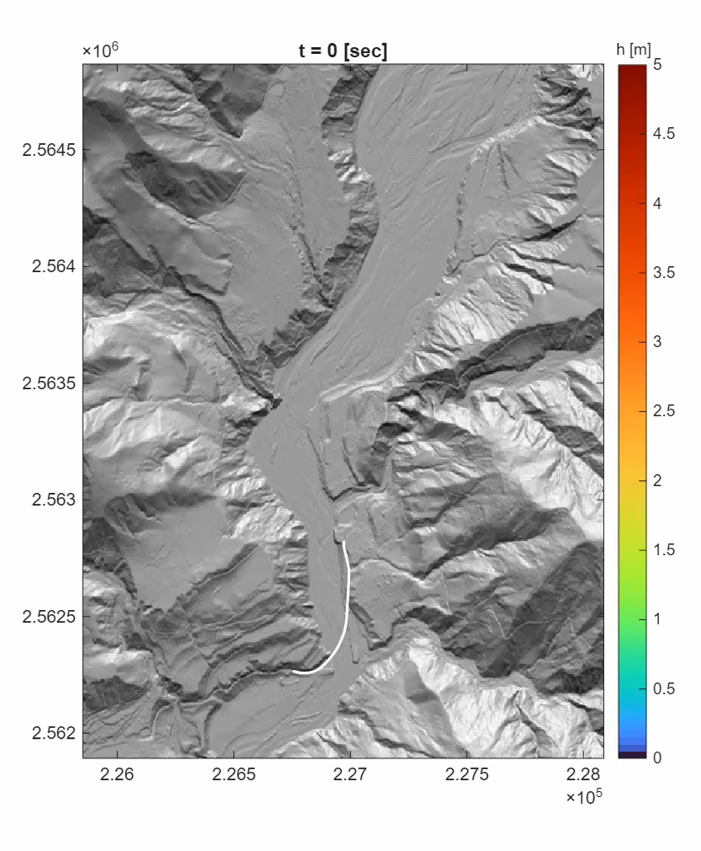
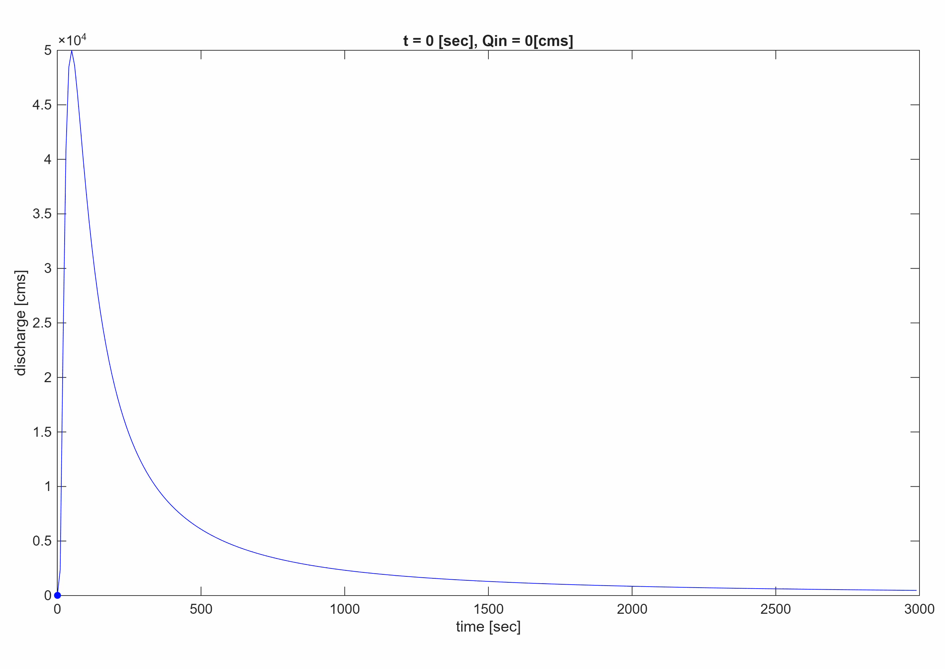
Single section analysis

Slide 18
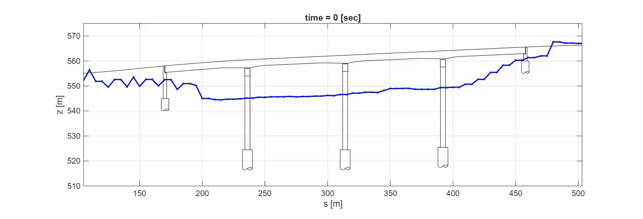
Single section analysis (ex. Water depth)

Slide 19
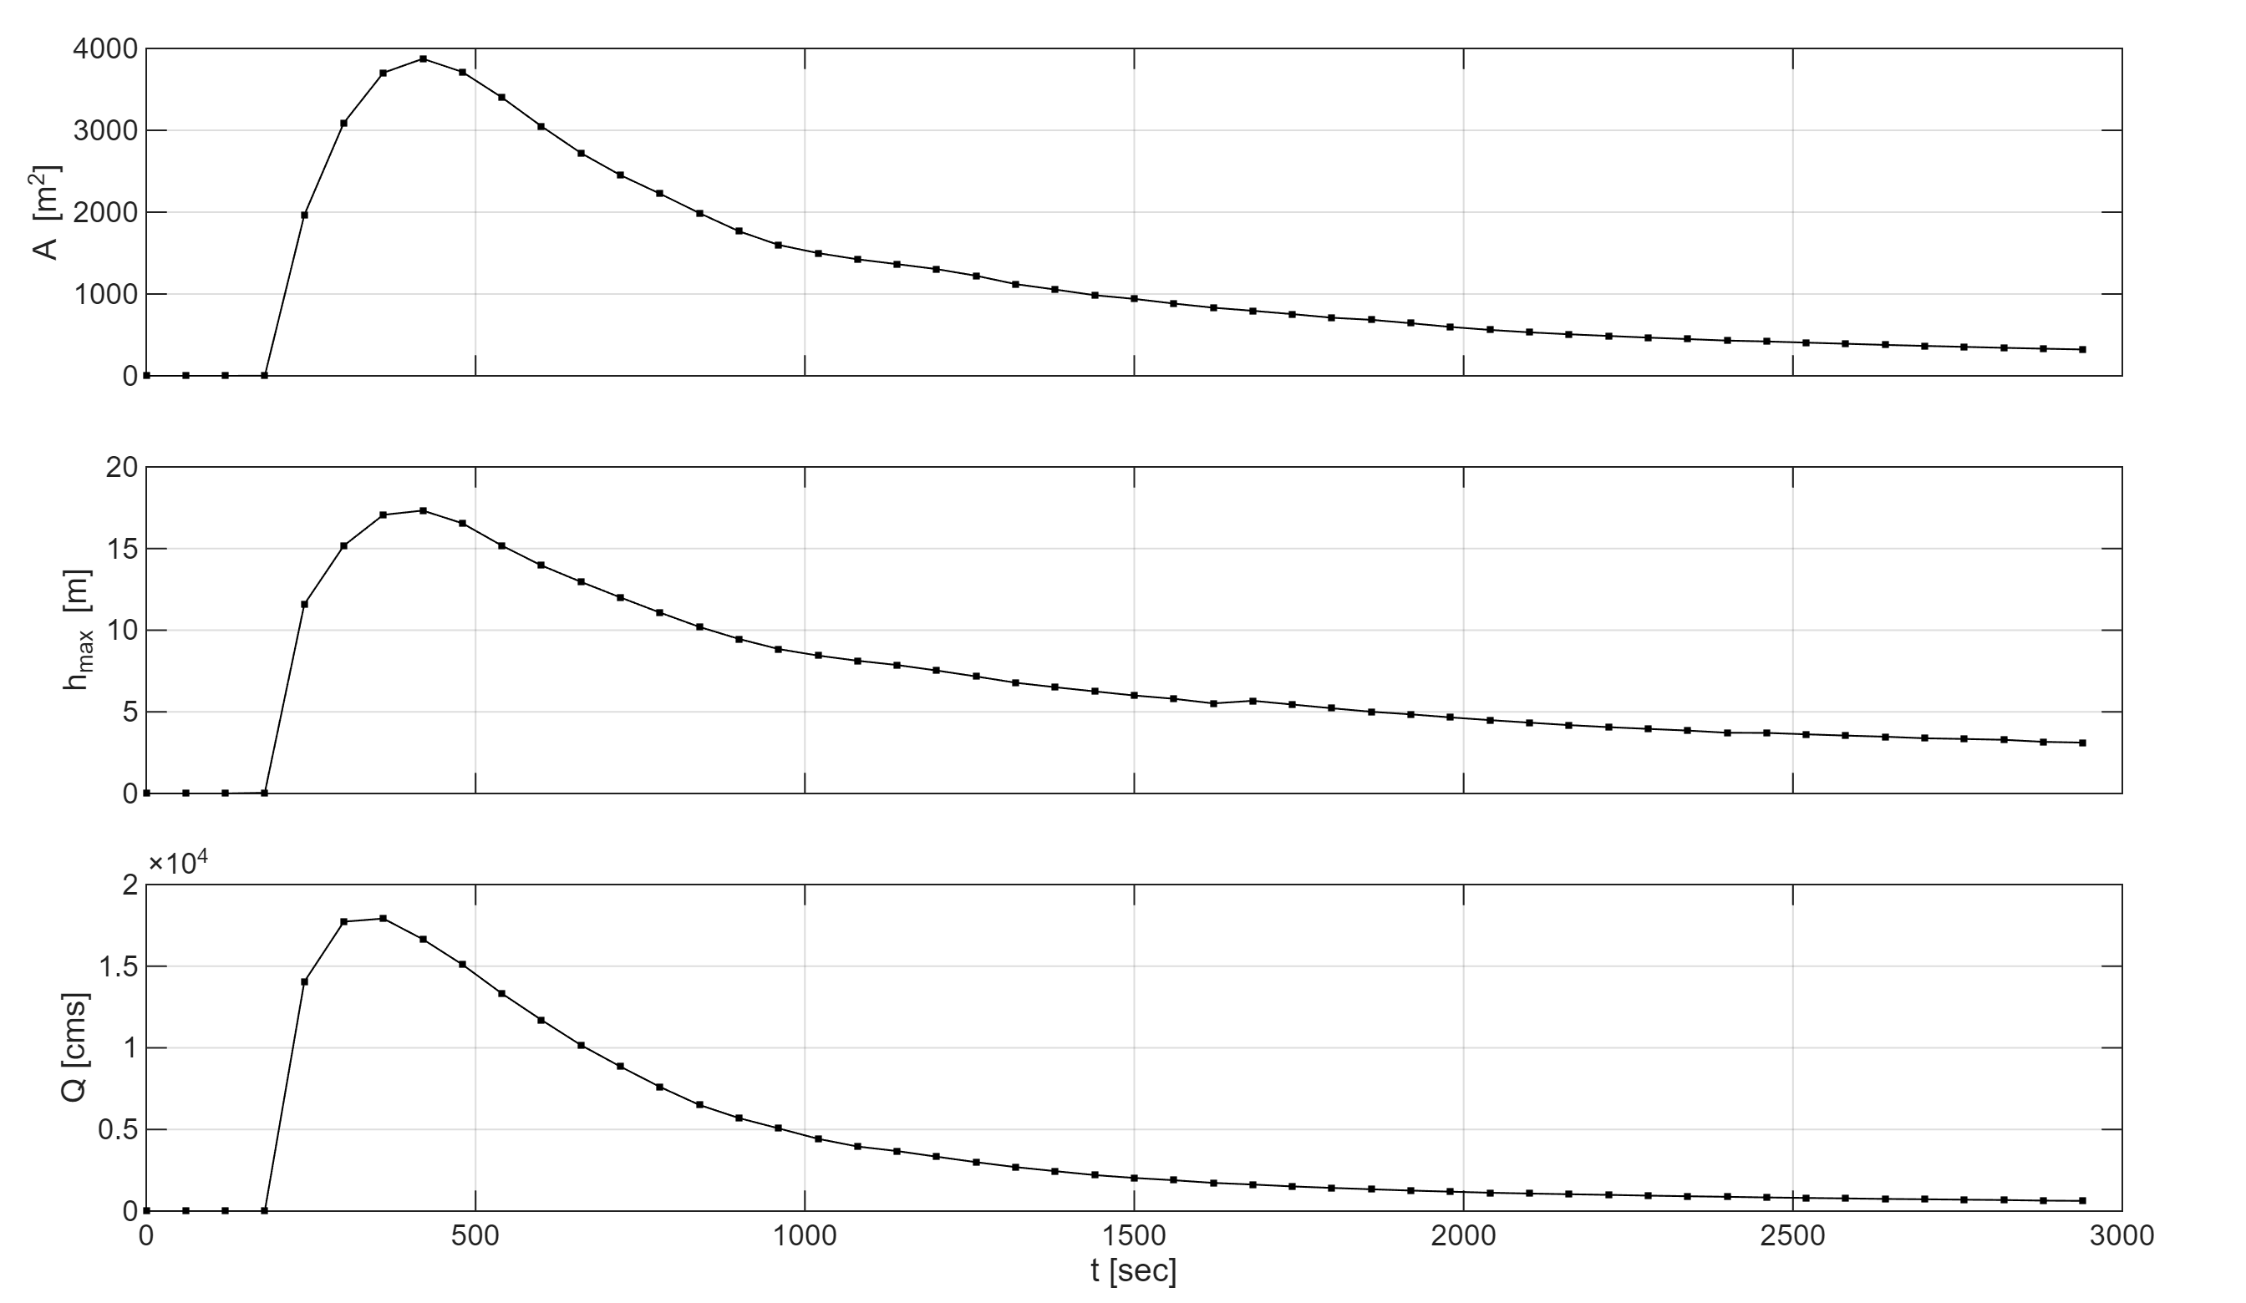

Slide 20
Final presentation
Final project (presentation upload due Dec 8 on NTU COOL) 16 min group presentation
Required:
Breaching: Dam breach hydrograph calculation.
Flooding: Mesh, BCs, model config.
Analysis: Inundation map and wave propagation (max depth, x-t plots, peak attenuation)
Bonus:
Validation: Compare model outcomes with observations and measured data.
Uncertainty: Sensitivity analysis with different dam breach assumptions.
Hazard mitigation: Evaluate an intervention that could have mitigated disaster.
Presentation in English for local students / Chinese for international students

Slide 21

NTUCE Course Evaluation Form
Please fill this form before you leave the classroom. Thank you!

